Slide 1


BlueCrest College Ghana
(Affiliated with University of Education Winneba)
5TH JUNE, 2014
PROJECT DOCUMENTATION
ON
MOBILE PHONE ANTI THEFT SYSTEM

Slide 2
TABLE OF CONTENTS
Preliminary Information
Chapter 1 (Project Proposal)
Chapter 2 (Literature Review)
Chapter 3 (Project Objectives , activities and Deliverables)
Chapter 4 (Requirement Analysis)
Chapter 5 (Design Techniques)
Chapter 6 Implementation / Testing
Chapter 7 End user guide

Slide 3
Chapter 1 – Project Proposal
Proposed Project Introduction
MATS will consist of a number of essential anti-theft features that many other devices do not contain. It will use android built in feature to retrieve the information about the change of SIM on your mobile phone incase its get lost or stolen; this project will also help in tracking down your stolen mobile with GPS and GPRS technology built in most of the smart phones to identify the location of your mobile phone Ref[1].
Why Mobile Anti-Theft System (MATS)
Almost every owner of a costly mobile handset fears the nightmare of losing his mobile phone which contains all his / secret information . I have come across many middle class people losing costly mobiles and unable to get back the same even with the help of police officers. And in AFRICA there is no system in place to help such people. Seeing their plight and the upcoming android platform which promises to be present on ever upcoming handset

Slide 4
Chapter 2 – Literature review
Historical Background about Android Technology
Initially developed by Android, Inc., which Google backed financially and later bought in 2005.
The first Android-powered phone was sold in October 2008ref[2]
Additionally, Android has a large community of developers writing applications ("apps") that extend the functionality of devices, written primarily in a customized version of the Java programming language ref[3].
A developer survey conducted in April–May 2013 found that Android is the most popular platform for developers, used by 71% of the mobile developer population ref[4].
These factor has contributed towards making android the best in the world.

Slide 5
Chapter 2 continuation……….
Major Android Technology Application Component
Android is a new and very user friendly operating system for mobile devices which includes key applications, middleware and even uses Linux Kernel modified version ref[5,6,
There are five different types of application components
Activities
Content Provider:
Broadcast Receiver:
Intent:
Services
Why I Chose Android Platform and Technology over Others ref[7,8,9]
Zero start-up cost to begin development with
Freedom to innovate
Freedom to collaborate
Multi-platform support
Fact findings on Mobile Theft Issues In Africa
An insatiable appetite for smartphones has turned the black market into a global enterprise, efficiently sending ill-gotten gadgets wherever demand is greatest ref[10]. But no one has a complete picture of the size or scope of the black market.

Slide 6
OBJECTIVES, ACTIVITIES AND DELIVERABLES
Objectives
1. To research on the trend on mobile theft in Africa and all the rest of the world
2. To build mobile App to send automatic SMS as when Phone SIM is swapped.
3. To build a location awareness on the MATS to detect the current location of the lost / stolen phone

Slide 7
Chapter 4 – Requirement Analysis
Requirement Analysis of the Existing and the New System
There are lot of Mobile Anti Theft software available in the market today, and all comes with their targeted functionality and platform, most effective mobile anti theft software has the basic functions and objective which is to check the position of a mobile phone, but majority of the software lack the main concept of the Anti theft system and the feasibility of detecting theft using the software.
Therefore, the proposed anti theft software will cover all the major flaws that those software was unable to capture. Example, the proposed application can be used has a mobile tracker.
Proposed Technology Infrastructure
ECLIPSE IDE
JAVA
XML
GOOGLE MAPS API
SQLLITE DATABASE
Software Requirement
Minimum Version Google Android OS 1.5
A mechanism to read from and write to non-volatile(persistent)memory
A timing mechanism for establishing timers and adding time stamps to persistent data
Sqllite database
Hardware Requirement
Any android mobile phones with ARM processor, GPS and GPRS support

Slide 8
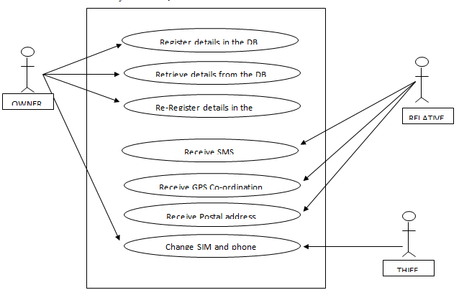
Chapter 5 – Technical Design
Preliminary Design
MATS consist of 3 core modules.
1. Database Module 2. Communication Module 3. Interface Mobile
Design Considerations
Input
IMSI (International Mobile Subscriber Identity) number of the SIM.
Alternate number of the Owner.
Name of the Owner.
Pre-defined text that will send to alternate number when SIM will change.
SMS that contain query string
Output
Text message stating that SIM has changed.
GPS Location of phone.
Postal Address of the phone
Use Case Diagram

Slide 9
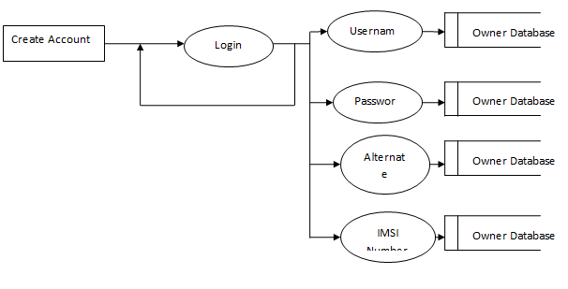
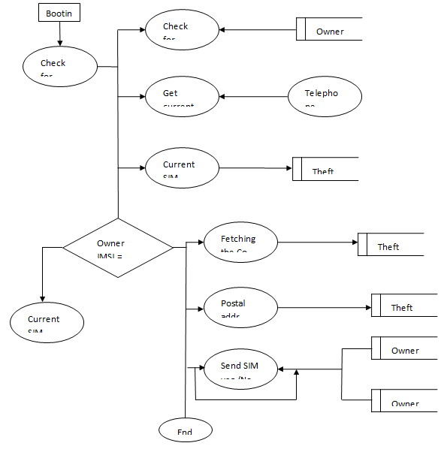
Foreground Data Flow Diagram
Background Data Flow Diagram
Entity relational Diagram
OWNER
1
Has
n1
RELATIVE
1
11
1
1
1
Has
Come across
Has
Has
n
1
Has
n
n
n
THIEF
1
Has
SIM
n
n
MOBILE DEVICE

Slide 10
Chapter 6 – Implementation / Testing
Database Module
Here in this module we develop a database using sqllite database which has one username, password, IMSI,IMEI, relatives’ phone number, and default message .
The Code below is used to create the MATS Database
@Override
public void onCreate(SQLiteDatabase _db)
{
_db.execSQL(LoginDataBaseAdapter.DATABASE_CREATE);
}
The Code below is used to Create the MATS Table which hold all the information required to interact with the MATS
static final String DATABASE_CREATE = "create table "+"LOGIN"+ "( " +"ID"+" integer primary key autoincrement,"+ "USERNAME text,PASSWORD text, PHONE text, MESSAGE text, IMEI text, IMSI text, HDID text,SERIALNO text, SERIALNO2 text, ANDROIDID text); ";
The code snippet below is used to insert record into the database
public void insertEntry(String userName, String password, String phone, String msg, String imei, String imsi, String hdID,String serialNo, String serialNo2, String androidId)
{
ContentValues newValues = new ContentValues();
// Assign values for each row.
newValues.put("USERNAME", userName);
newValues.put("PASSWORD",password);
newValues.put("PHONE", phone);
newValues.put("MESSAGE", msg);
newValues.put("IMEI", imei);
newValues.put("IMSI", imsi);
newValues.put("HDID", hdID);
newValues.put("SERIALNO", serialNo);
newValues.put("SERIALNO2", serialNo2);
newValues.put("ANDROIDID", androidId);
// Insert the row into your table
db.insert("LOGIN", null, newValues);
///Toast.makeText(context, "Reminder Is Successfully Saved", Toast.LENGTH_LONG).show();
}
The Methods below are used to connect and close the database
public LoginDataBaseAdapter open() throws SQLException
{
db = dbHelper.getWritableDatabase();
return this;
}
public void close()
{
db.close();
}

Slide 11
Core Module Implementation
This module is related to user interface. Getting user input , validating it and then connecting to database module to commit the same if already registered user has to enter valid password to gain access to interface
This class UserData is used to connects to database module and uses its API’s via onClick() method to store data.
public void onClick(View v) {
String userID2 = userIDText.getText().toString();
String phone2 = phoneText.getText().toString();
String password2 = passwordFieldText.getText().toString();
String msg2 = msgFieldText.getText().toString();
if(userID2.equals("")|| phone2.equals("")|| password2.equals("")||msg2.equals(""))
{
Toast.makeText(getApplicationContext(), "Field Vaccant", Toast.LENGTH_LONG).show();
return;
}
else
{
final SharedPreferences settings = getSharedPreferences(PREV_NAME, 0);
String password = settings.getString("password", "1234");
String imsi = settings.getString("imsi", "imsiString");
String hdID = settings.getString("hwID", "hwID");
String serialNo3 = settings.getString("serialNo2", "serialNo2");
String androidid = settings.getString("androidId", "androidId");
String msg = settings.getString("msg", "msg");
loginDataBaseAdapter.insertEntry(userID2, password, phone2, msg, password2, imsi, hdID, msg2, serialNo3, androidid);
Intent myintent = new Intent(getApplicationContext(), UserProfile.class);
startActivity(myintent);
Toast.makeText(getApplicationContext(), "Account Successfully Created ", Toast.LENGTH_LONG).show();
}
}
The onCreate method is used to build the interface and its component while loading the App
protected void onCreate(Bundle savedInstanceState){}
The onClickListener() method is used to listens for the button click event and performs the action specified.
submit.setOnClickListener(new View.OnClickListener() {}
The onDestroy() method is used to unregister any communication on closing the Interface.
protected void onDestroy() {
super.onDestroy();
}

Slide 12
Communication Module
This module deals with communication. It intimates the relative on SIM change, responds to incoming SMS, gets the GPS co-ordinates and sends it to the relative, connects to internet sends the GPS co-ordinates to Google maps and gets the postal address from it and forwards it to the relatives phone number. The communication here is with satellites, with other mobile phone and on internet.
SMSReceiver class
This class extends broadcastReceiver class. broadcastReceiver class receives the system wide events . SMSReceiver class is invoked when an sms is received. When this class is executed it check if the SMS starts with a particular string if so then it proceeds execution else it stops
MYReceiver class
This class extends broadcastReceiver class. broadcastReceiver class receives the system wide events . MYReceiver class is invoked when SIM is rebooted. When this class is executed it check if the SIM is changed so then it proceeds execution else it stops
Methods called
public void onReceive(Context context, Intent intent) {}
When Intent broadcast is being received by a BroadcastReciever, this process will be called, therefore, all information related to checking incoming / replying SMS is handled using the method.
Methods called
public void onReceive(Context context, Intent intent) {}
When Intent broadcast is being received by a BroadcastReciever, this process will be called, therefore, all information related to checkingSIM swap and auto alert The Relative as the SIM swap
MYSerivce class
This class extends IntentService class. IntentService class runs on the android Background to keep the Application alive, and call any respective Broadcast receiver or activity as when needed.

Slide 13
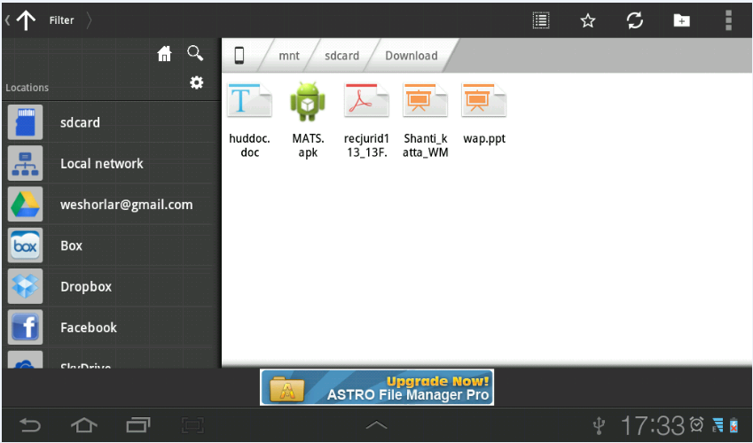
7.1 Installing the MATS Application on Android Phone
Step 1: Install File Manager
Step 2: Copy MATS.apk file to SD card

Slide 14
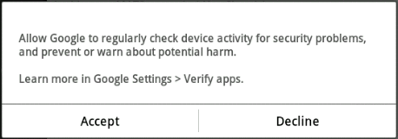
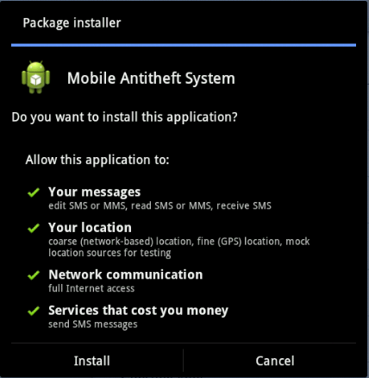
This will display an agreement dialog box for the installation
On the next two pages select “Install” again to install the MATS.apk

Slide 15
Conclusion
On theft detection my Application system would send an SMS to the owner alerting him of the phone number of the thief without the knowledge of thief in stealth mode.
Then our system would retrieve GPS co-ordinates from satellites and then send a SMS within a second. it would
retrieve the postal address of the stolen phone and send it as an SMS to the relatively stored number, this functionality is not found on any of the existing anti-theft system.
Later I can implement some telecom concepts, so that the user will get the information about the activities of the company in a mobile device.

Slide 16
REFERENCES
S/N | SOURCE | Type
1 | Godfrey Ikhemuemhe, 3/oct/2003, http://allafrica.com/stories/20031013292.html | News Report
2 | http://siteresources.worldbank.org/EXTINFORMATIONANDCOMMUNICATIONANDTECHNOLOGIES/Resources/282822-1346223280837/MainReport.pdf | Tech News Report
3 | http://www.openhandsetalliance.com/android_overview.html | Tech Documentation
4 | http://www.developereconomics.com/reports/q3-2013/ | News Report
5 | http://www.canalys.com/newsroom/google%E2%80%99s-android-becomes-world%E2%80%99s-leading-smart-phone-platform | News journal
6 | http://www.phonearena.com/news/Android-steals-Symbians-Top-Smartphone-OS-crown_id16332 | News Journal
7 | http://arstechnica.com/gadgets/2012/11/on-androids-5th-birthday-5-things-we-love-about-android/ | Tech Discussion
8 | http://www.androidpolice.com/2010/05/01/custom-roms-for-android-explained-and-why-you-want-them/ | Tech Report
9 | http://techcrunch.com/2013/07/01/android-led-by-samsung-continues-to-storm-the-smartphone-market-pushing-a-global-70-market-share/?ncid=tcdaily | News Report
10 | http://news.cnet.com/8301-30686_3-20092399-266/google-just-bought-itself-patent-protection/ | Tech Trends

